Slide 1
Yeast Gene Regulatory Network Reverse Engineering
Bing Wang

Slide 2
Background

Slide 3
Goal

Slide 4
Workflow
Construction
Visualization
Verification
Analysis

Slide 5
Workflow
Construction
Visualization
Verification
Analysis

Slide 6
Data Collection
7388 Microarrays
290444 Interactions
88051 GO Annotations
73074 Phenotype Annotations
16940 Gene Annotations

Slide 7
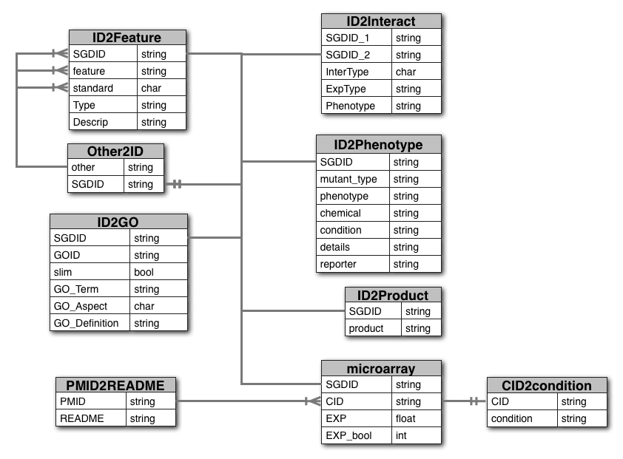
Database

Slide 8
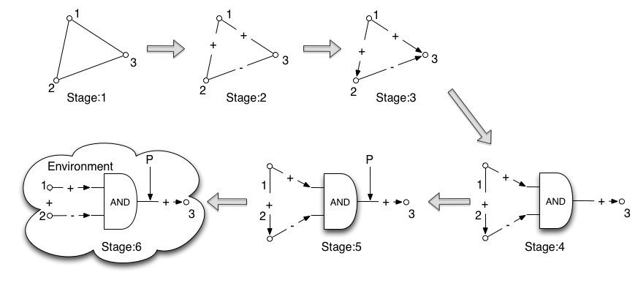
System Stages

Slide 9
System Stages

Slide 10
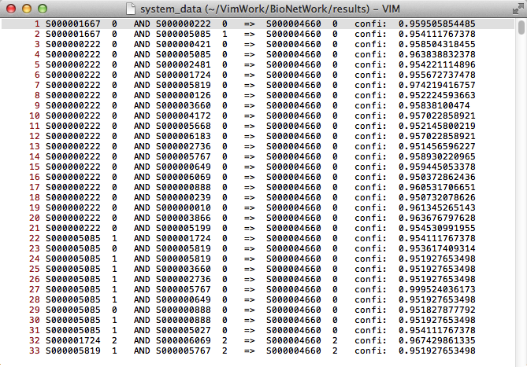
Stage：5

Slide 11
Workflow
Construction
Visualization
Verification
Analysis

Slide 12
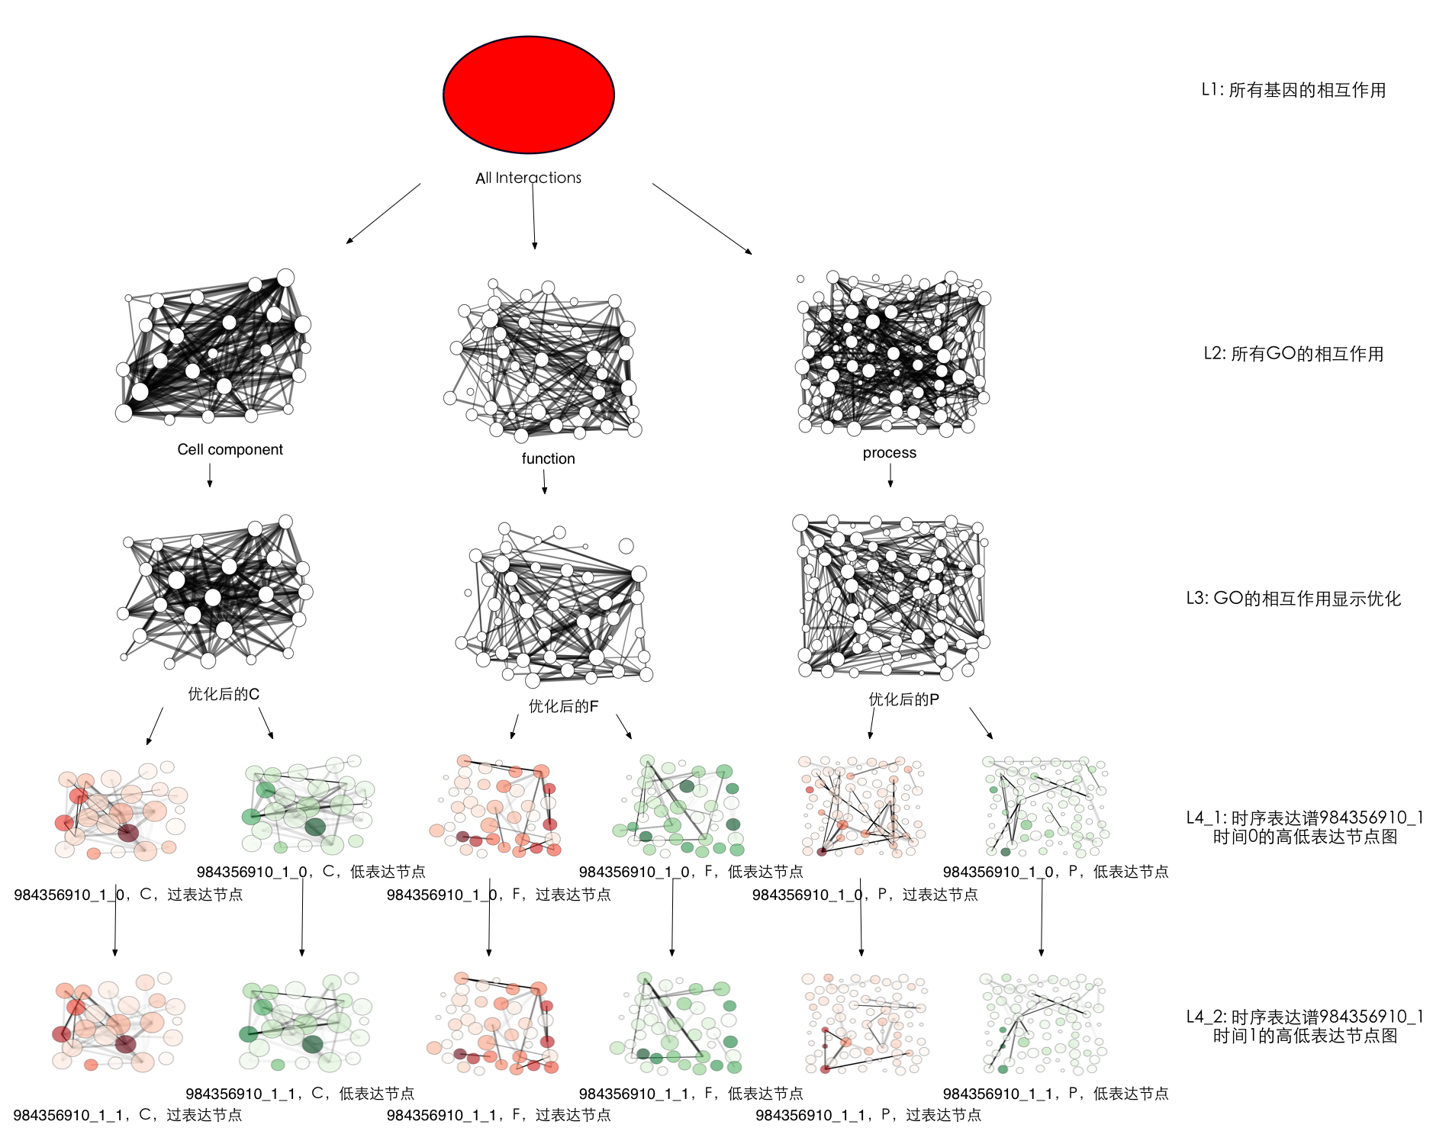

Slide 13
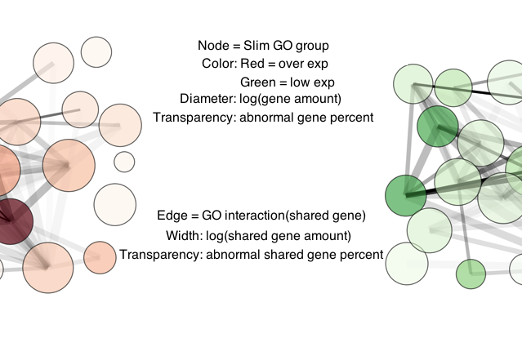
Legend

Slide 14
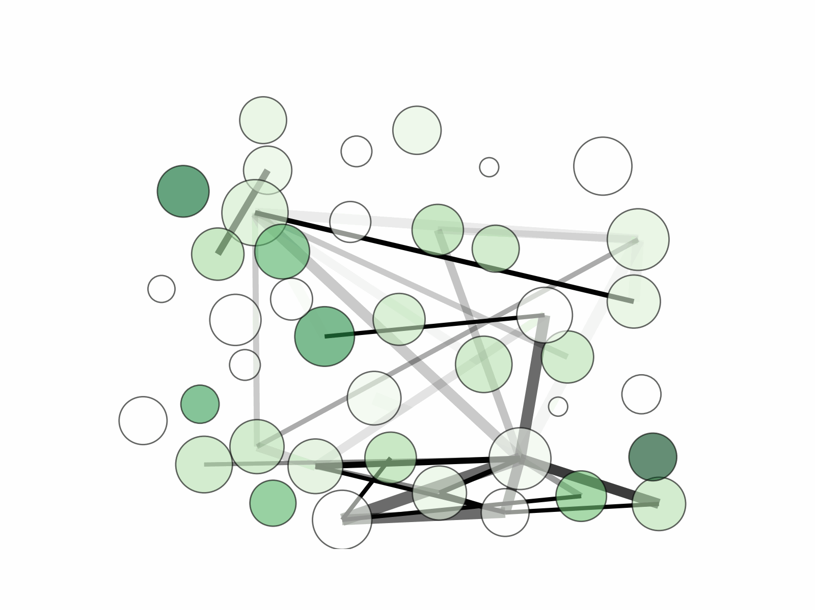
Visualization
GO = Function ; Part = Low exp genes ; Stress = Nitrogen Depletion

Slide 15
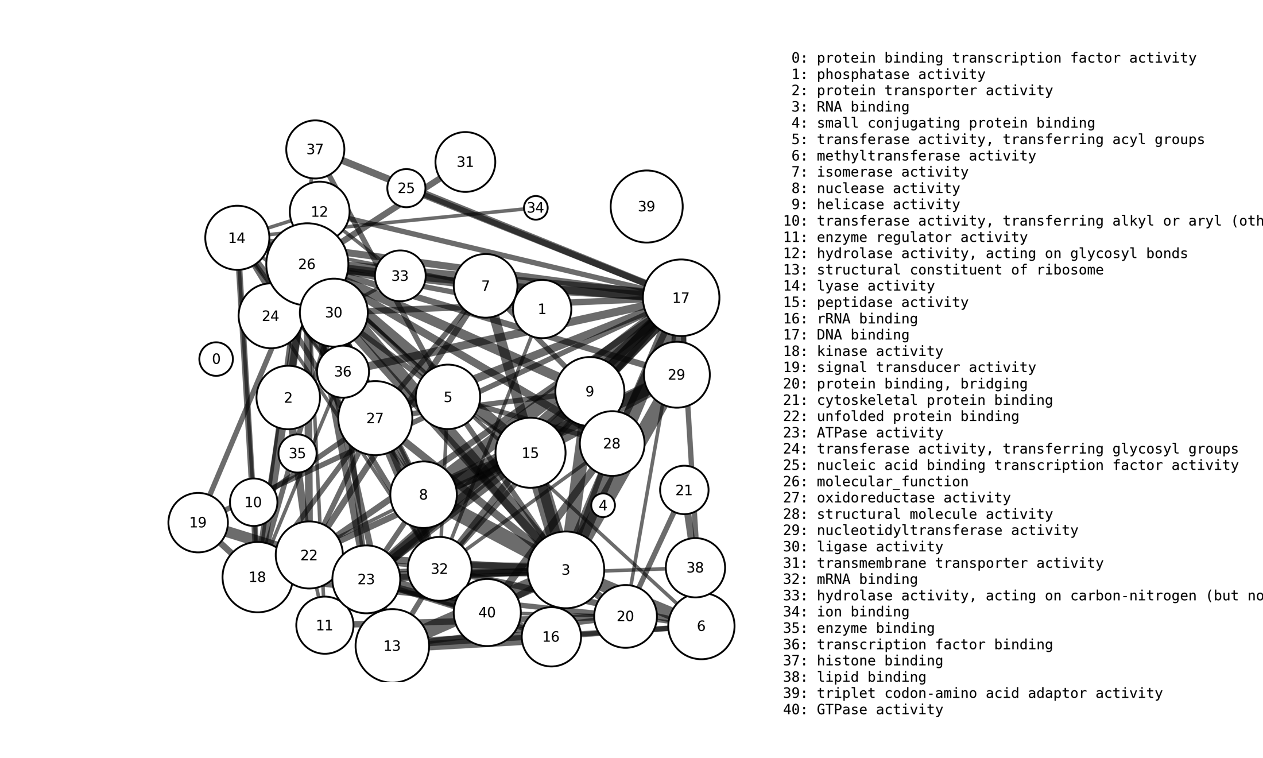
GO description

Slide 16
Workflow
Construction
Visualization
Verification
Analysis

Slide 17
Predict one expression
Accuracy of prediction
Normal gene | <10% | 10% | 20% | 30% | 40%
 | 19.6% | 32.5% | 45.0% | 56.1% | 67.5%
Normal gene | 50% | 60% | 70% | 80% | >90%
 | 79.4% | 93.5% | 95.1% | 95.7% | 97.0%

Slide 18
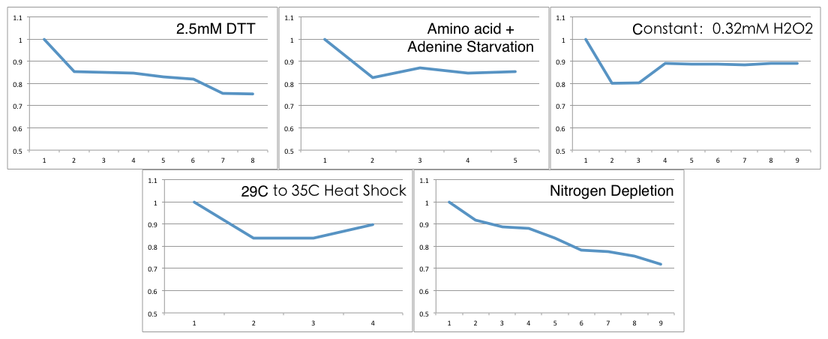
Predict time series expression

Slide 19
Workflow
Construction
Visualization
Verification
Analysis

Slide 20
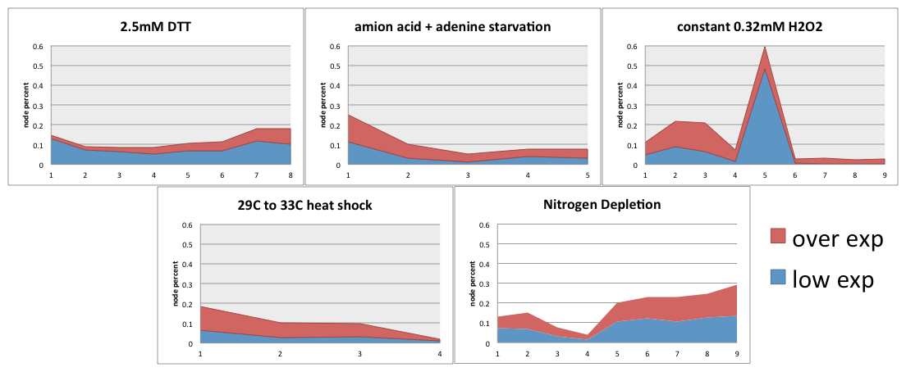
System robustness

Slide 21
Modularity
 | Modularity | Averagenode reuse | Average overlap
Function | 0.117 | 7.0% | 4.6%
Cell component | 0.250 | 28.0% | 10.9%
Process | 0.176 | 4.0% | 2.5%
S.cer | 0.236 | 7.2% | 2.1%
E.coli | / | 3.5% | 4.3%
Linux | / | 8.4% | 80.7%

Slide 22
Source code
https://github.com/BingW/BioNetWork

Slide 23

Acknowledgement
Dr.Hittinger
Dr.Laurence
Meihua Kuang
Dr.Yanhong Zhou

